Slide 1


Titolo presentazione sottotitolo
DISTRIBUTED DEEP LEARNING APPROACHES FOR
HEALTHCARE: A COMPARISON OF SPLIT LEARNING
AND FEDERATED LEARNING FOR AUTOMATIC
DISEASES DETECTION IN CHEST X-RAYS
Milano, XX mese 20XX
Advisor: Prof. Daniele LOIACONO Co-advisor: Dr. Edoardo GIACOMELLO
Michele CATALDO
Matr. 898954

Slide 2
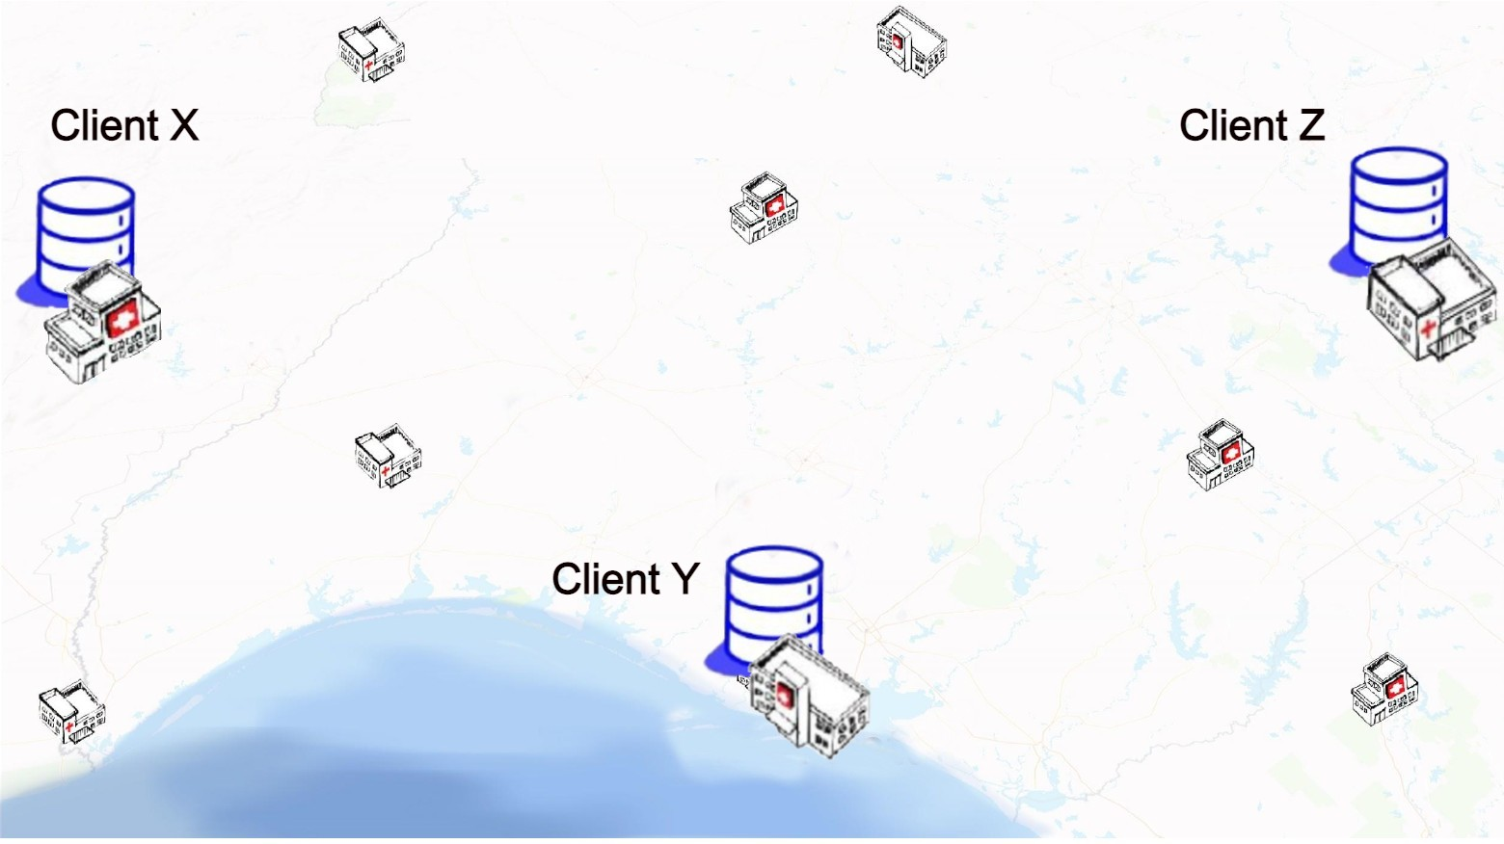

Machine Learning in Healthcare
Standard approach:
Insufficient data for training a model
Data aggregation across a single hospital institution
Healthcare context:
Privacy and confidentiality of sensitive data
Heterogeneous data

Slide 3
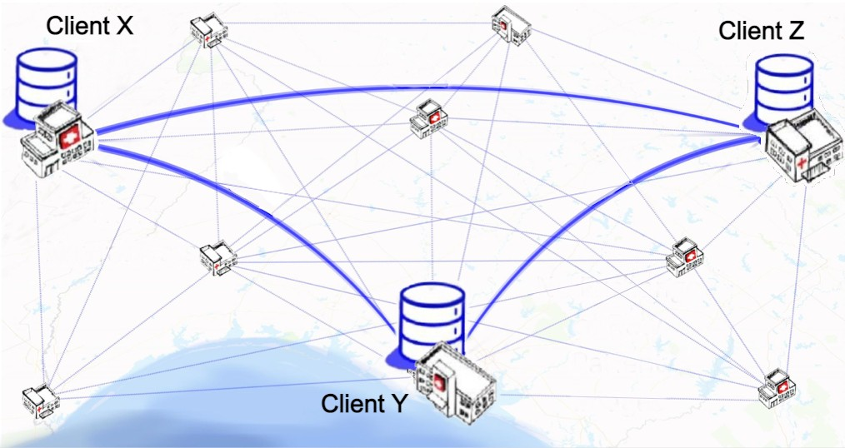

Distributed Deep Learning in Healthcare
Distributed Deep Learning:
Patient privacy
No exchange of raw data
Distributed data enough to train a Neural Network
Efficiency
Federated
Learning
Split
Learning

Slide 4
Outline
Problem formulation
Federated Learning
Problem formulation
Experimental design
Results
Future improvements
Split Learning

Slide 5
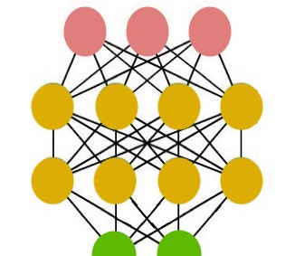
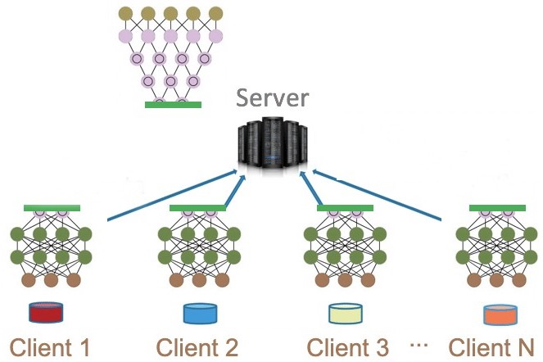
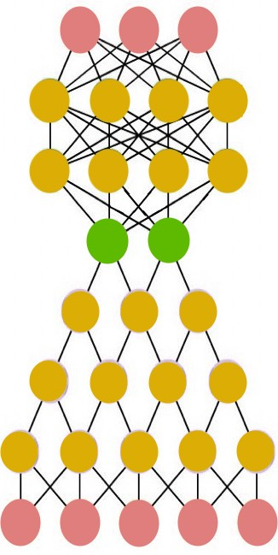
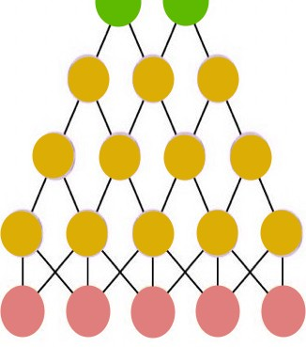
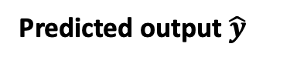
Split Learning: Definition
Key idea:
Divide the Neural Network based on a Cut Layer in order to build N client networks on which the raw data are processed. The training is completed by the server after receiving the cut layer outputs from clients.
Predicted output $\hat{y}$
Server
Server
Cut Layer
Client
Client 1
Client 2
Client 3 …
Client N
Input data X

Slide 6
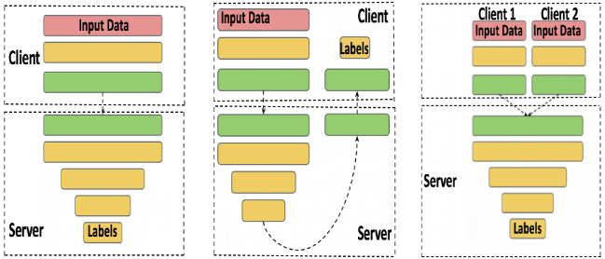
Split Learning: Architectures
Modified
Split Learning
for vertically
partitioned data
Simple Vanilla
Split Learning
U-Shaped Split Learning
(without label sharing)

Slide 7
Outline
Split Learning
Split Learning
Problem formulation
Experimental design
Results
Future improvements
Federated Learning

Slide 8
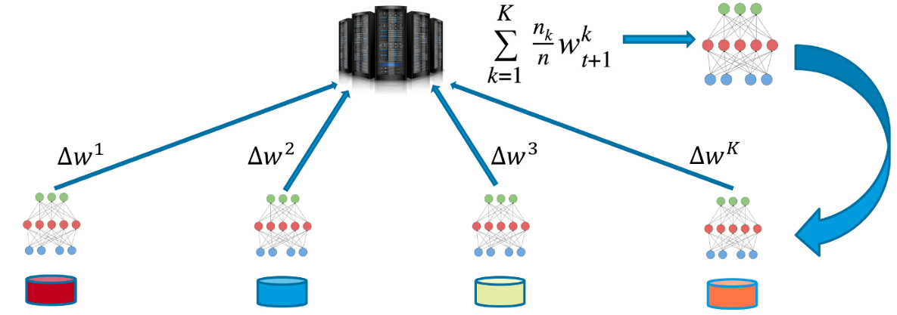
Federated Learning: Definition
Key Idea:
Decentralization of the model. The global model provided by the server is shared among clients, who train it with their data and send back to the server. The server aggregates all the weights and updates the global model.
Server
Client 1
Client 2
Client 3
…
Client K

Slide 9
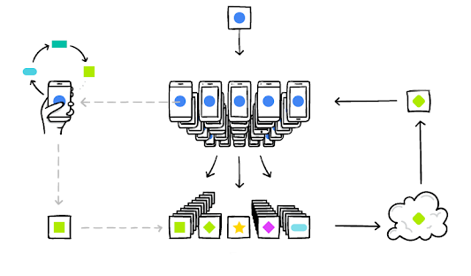
Federated Learning: Workflow
CLIENTS SELECTION
1.
2) MODELS UPDATING
2.
3) REPORTING
4.
4) AGGREGATION
3.

Slide 10
Outline
Split Learning
Federated Learning
Federated Learning
Experimental design
Results
Future improvements
Problem formulation

Slide 11
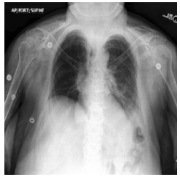
Problem formulation
Goal:
Application of Distributed Deep Learning methods for diseases diagnosis using chest X-rays (CXR)
Definition:
Models classify a given sample X
to a vector Y, corresponding to 14 different diseases
No Finding | Enlarged Cardiomediastinum | Cardiomegaly | Lung Opacity | Lung Lesion | Edema | Consolidation
Pneumonia | Atelectasis | Pneumothorax | Pleural Effusion | Pleural Other | Fracture | Support Devices
Multilabel Classification Problem

Slide 12
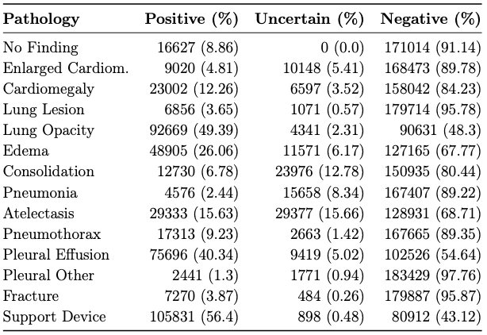
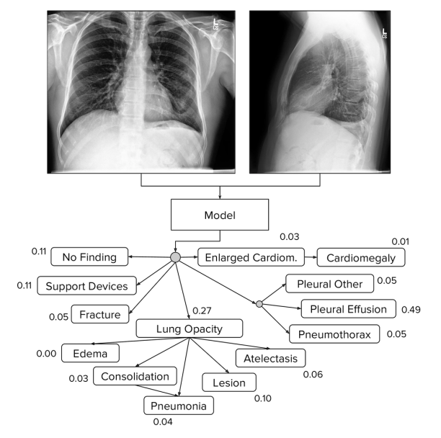
Problem formulation: CheXpert dataset
CheXpert dataset provided by Stanford University is composed of 224.316 chest X-rays of 65.240 patients

Slide 13
Outline
Split Learning
Federated Learning
Problem formulation
Experimental design
Results
Future improvements
Experimental design

Slide 14
Experimental Design: Network architectures
5 Clients - 1 Server
Neural Networks architecture: MobileNet
Evaluation metric: AUROC
Training set: 152.381 samples (80%)
Validation set: 38.246 samples (20%)
Up. Benchmark: Centralized model
Target diseases:
Atelectasis | Cardiomegaly | Consolidation | Edema | Pleural Effusion
AUC < 0.7: Bad classifier
0.7 < AUC < 0.8: Good classifier
0.8 < AUC < 0.9: Excelent
AUC > 0.9: Outstanding
Low. Benchmark: Local models

Slide 15
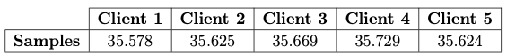
Experimental Design
1st dimension: Data sharing granularity
Split Learning
Federated Learning
fine coarse medium
fine coarse
2nd dimension: Pathologies distribution among clients datasets
Uniform datasets: randomly distributed pathologies
Unbalanced datasets: each client has a prevalence of at least 45% of a specific pathology
Consolidation
Cardiomegaly
Atelectasis
Edema
Pleural Effusion

Slide 16
Outline
Split Learning
Federated Learning
Problem formulation
Experimental design
Results
Future improvements
Results

Slide 17
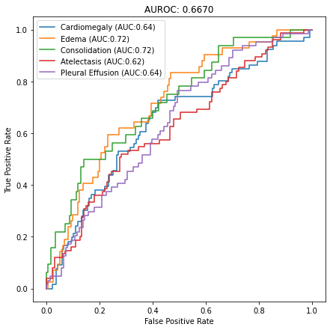
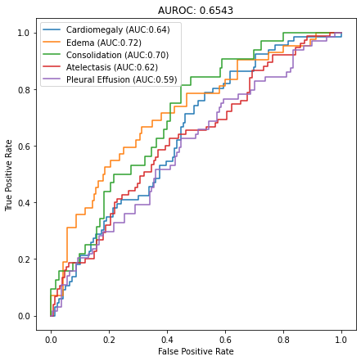
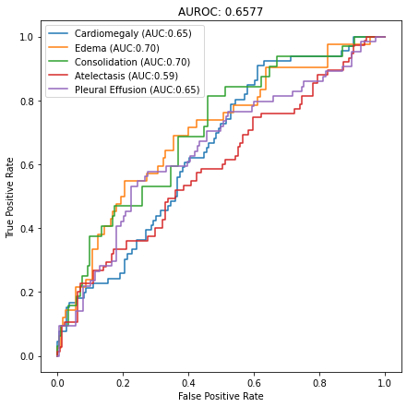

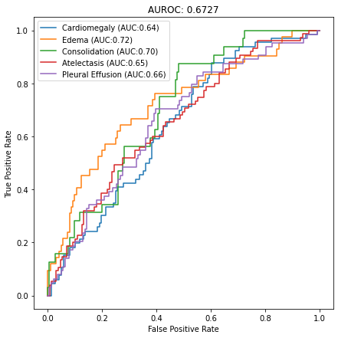
Results: Uniform Datasets – Local Models
Client 1
AUC = 0.6670
Mean AUC:
0.6604
Client 2
AUC = 0.6543
Client 3
AUC = 0.6577
Client 4
AUC = 0.6502
Client 5
AUC = 0.6727

Slide 18
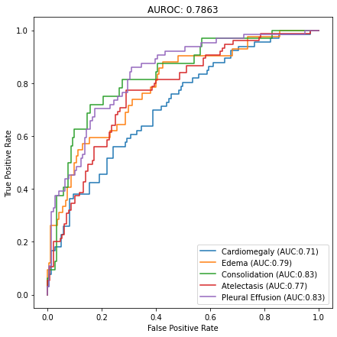
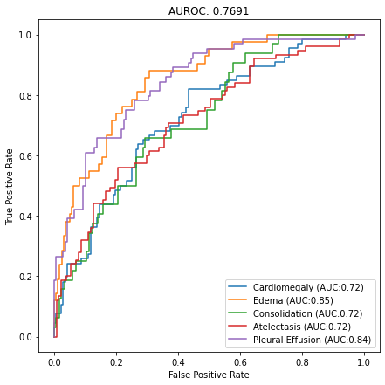
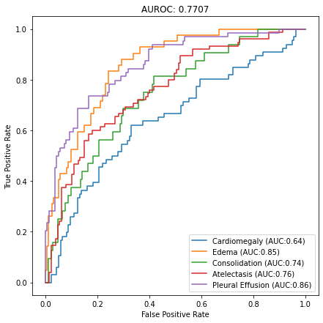
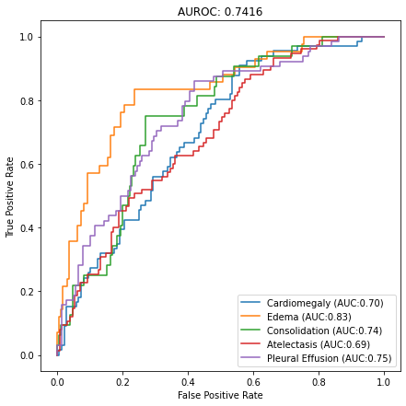
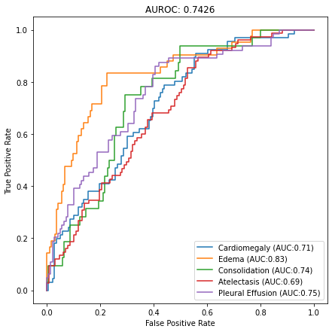
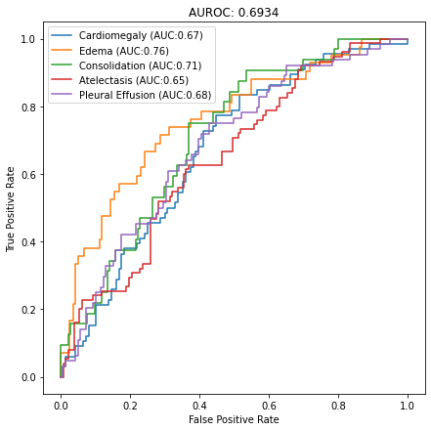
Results: Uniform Datasets
Centralized model
AUC = 0.7863
Centralized model
AUC = 0.7863
FL with coarse
AUC = 0.7691
FL with fine
AUC = 0.7707
Local Models
AUC = 0.6604
SL with coarse
AUC = 0.7416
SL with fine
AUC = 0.7426
SL with medium
AUC = 0.6934

Slide 19
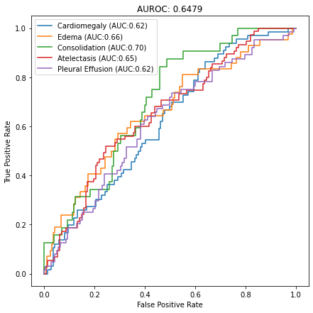
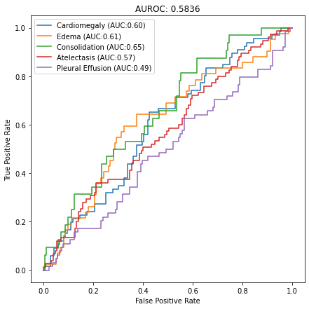

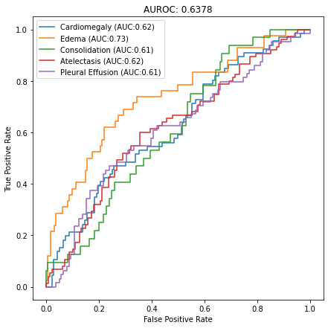
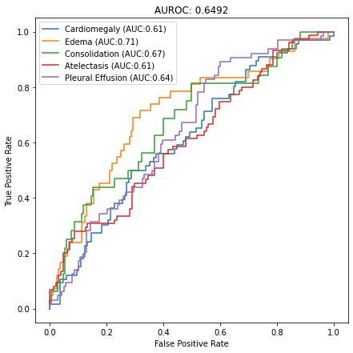
Results: Unbalanced Datasets – Local Models
Client 1
(Consolidation)
AUC = 0.6479
Mean AUC:
0.6263
Client 2
(Cardiomegaly)
AUC = 0.5836
Client 3
(Atelectasis)
AUC = 0.6607
Client 4
(Edema)
AUC = 0.6378
Client 5
(Pleural effusion)
AUC = 0.6492

Slide 20
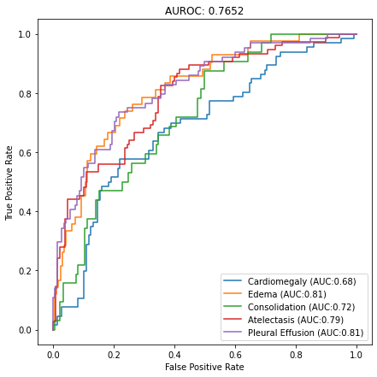
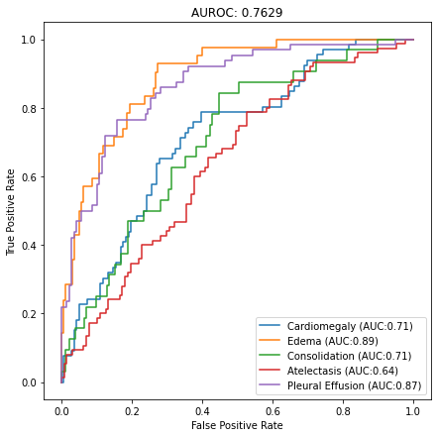
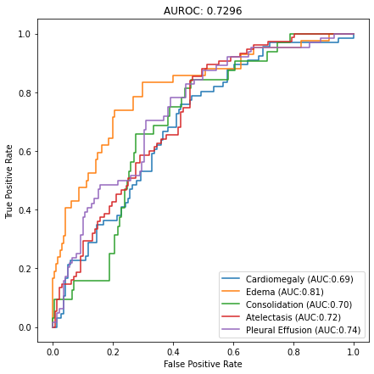
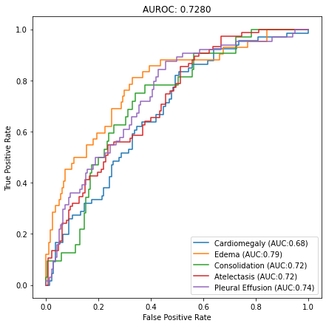

Results: Unbalanced Datasets
Centralized model
AUC = 0.7863
FL with coarse
AUC = 0.7652
FL with fine
AUC = 0.7629
Local Models
AUC = 0.6263
SL with coarse
AUC = 0.7296
SL with fine
AUC = 0.7280
SL with medium
AUC = 0.6667

Slide 21
Results: Summary
Learning Paradigm | Data Sharing Granularity | Uniform Datasets | Unbalanced Datasets
Centralized Model | - | 0.7863
Federated Learning | Coarse | 0.7691 | 0.7652
 | Fine | 0.7707 | 0.7629
Split Learning | Coarse | 0.7416 | 0.7269
 | Fine | 0.7426 | 0.7280
 | Medium | 0.6934 | 0.6667
Local Models | - | 0.6604 | 0.6263
FL better than SL
Uniform datasets slightly better than Unbalanced ones
NO impact with change in sharing granularity
Split Learning with medium grain data sharing is not a good classifier

Slide 22
Outline
Split Learning
Federated Learning
Federated Learning
Experimental design
Results
Limitations and
Future improvements

Slide 23




Future improvements
Limitations
Proposed Solution
Split Learning implementation
Neural Network Architecture
PyTorch and PySyft
Different architectures such as DenseNet121 or VGG19
Use both Frontal and Lateral CXRs, as well as all patient information (sex, age)

Slide 24

GRAZIE PER L’ATTENZIONE

